Slide 1
24MAT120
S2 P & M

Slide 2
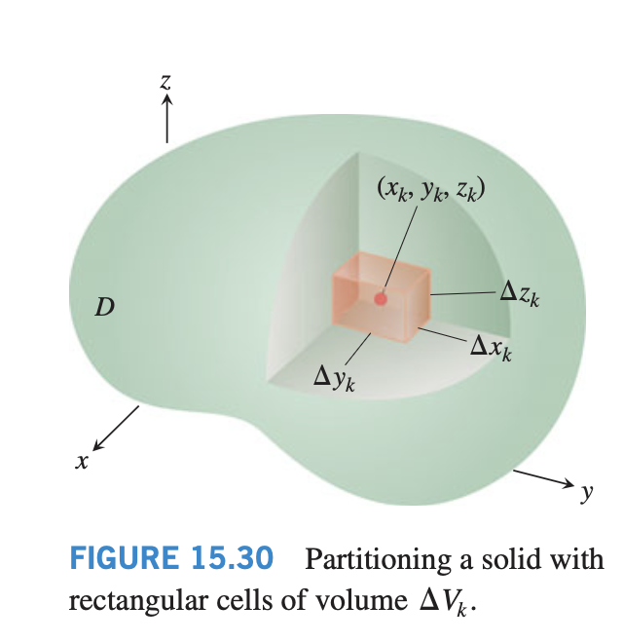
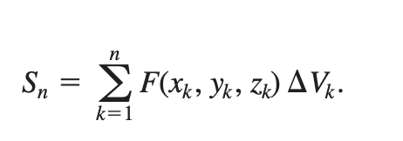
Triple Integrals

Slide 3
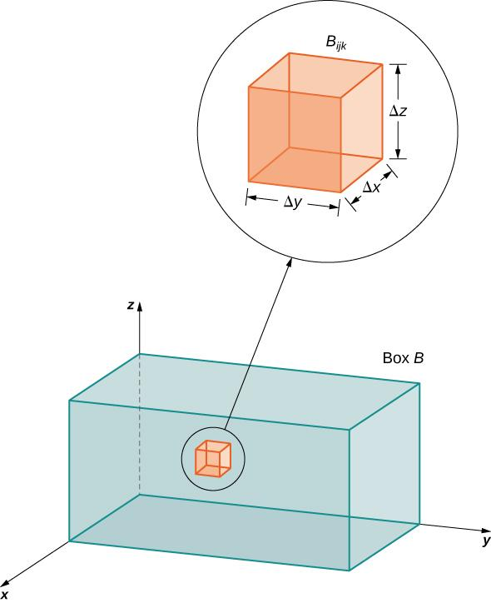
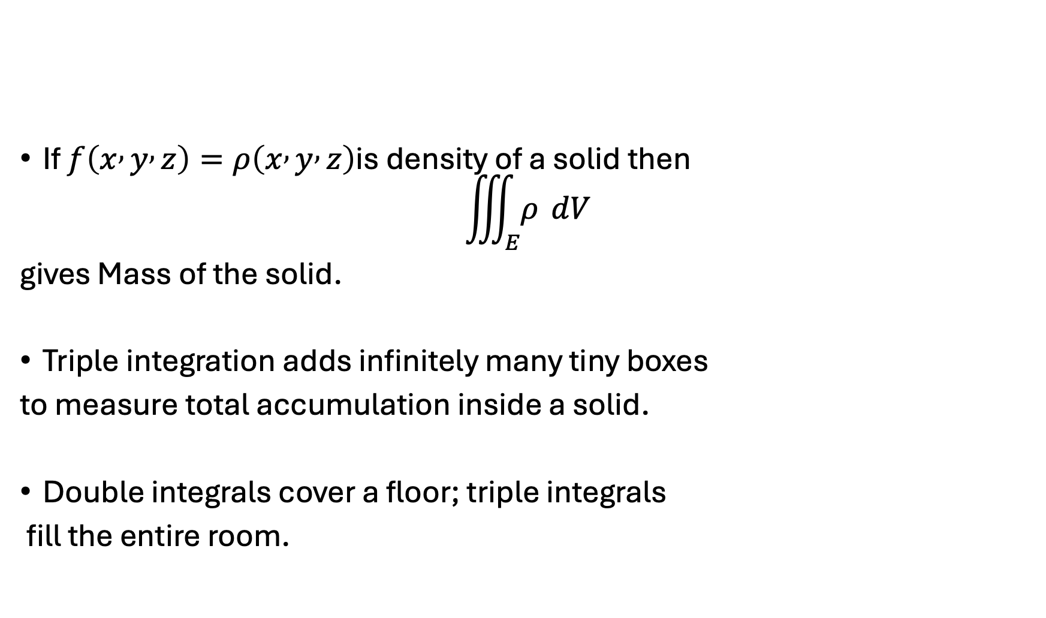
Physical Meaning
If $f\left(x , y , z\right)=ρ\left(x , y , z\right)$is density of a solid then
$$\iiint_{E}{ρ} dV$$
gives Mass of the solid.
Triple integration adds infinitely many tiny boxes
to measure total accumulation inside a solid.
Double integrals cover a floor; triple integrals
fill the entire room.

Slide 4
Applications
volume of solids
mass of variable-density objects
center of mass
charge distributions
fluid quantities
probability in 3 variables

Slide 5


Slide 6
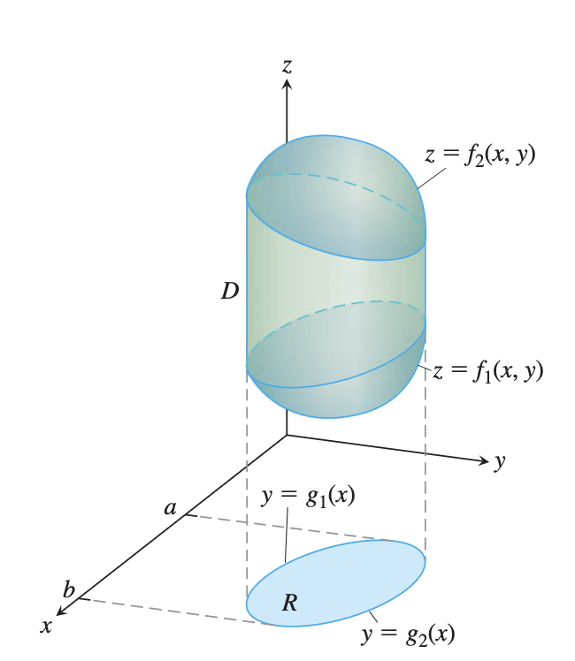
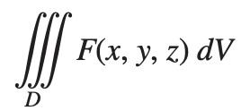
Finding Limits of Integration in the Order dz dy dx
Sketch the region D along with its “shadow” R (vertical projection) in the xy-plane. Label the upper and lower bounding surfaces of D and the upper and lower bounding curves of R.

Slide 7
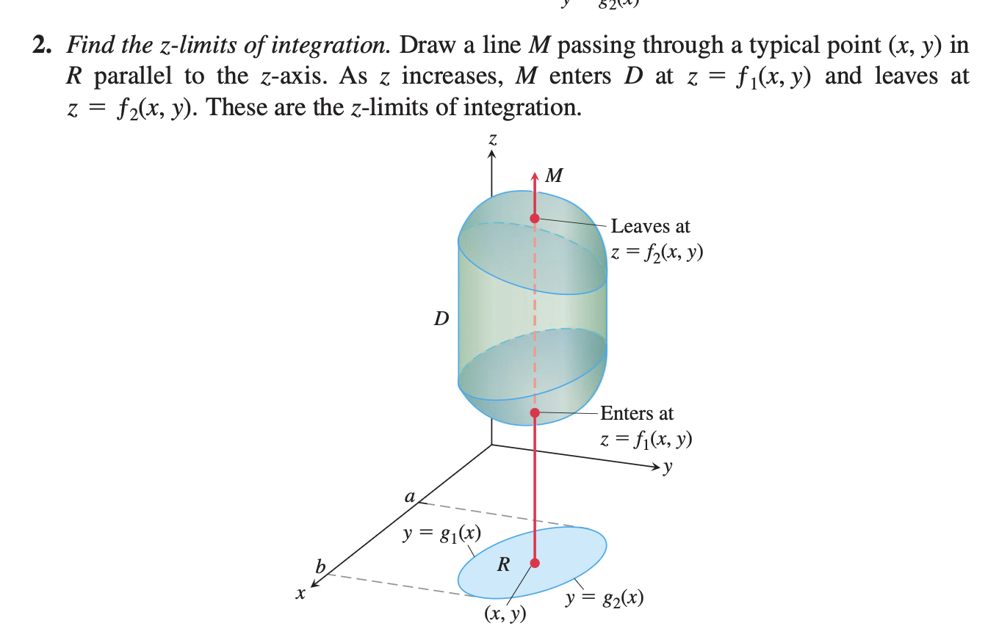

Slide 8
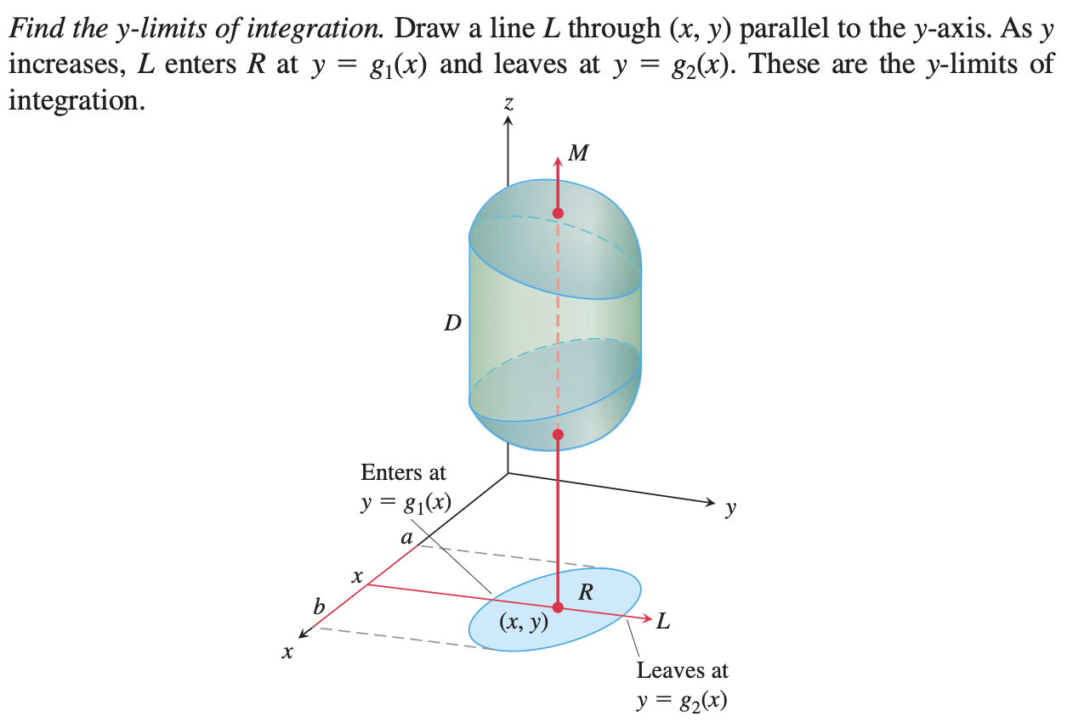

Slide 9
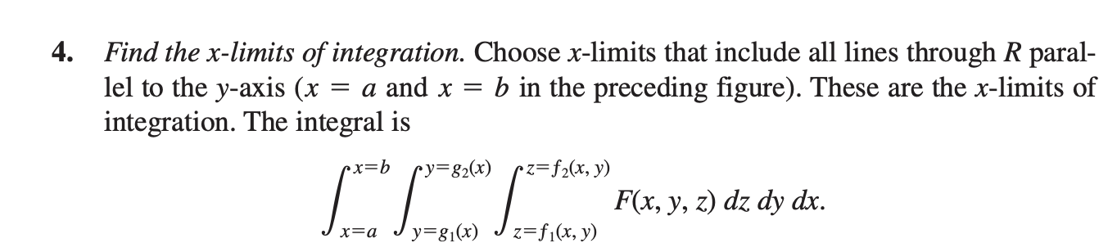

Slide 10
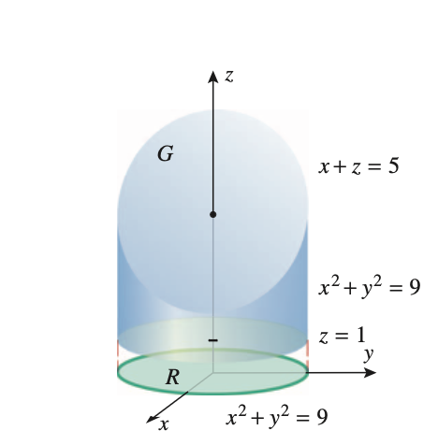
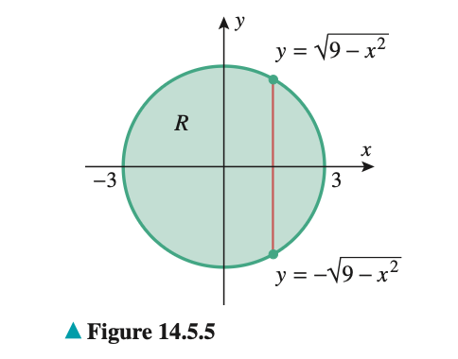
Use a triple integral to find the volume of the solid within the cylinder x² + y² = 9 and between the planes z = 1 and x + z = 5.

Slide 11
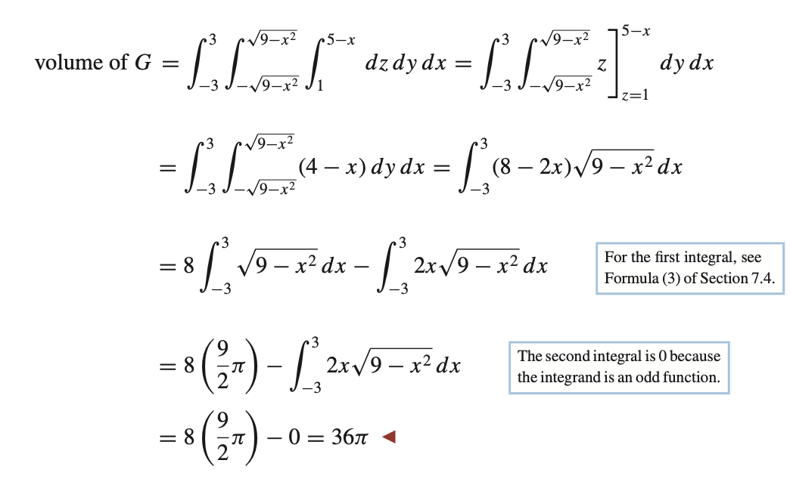

Slide 12
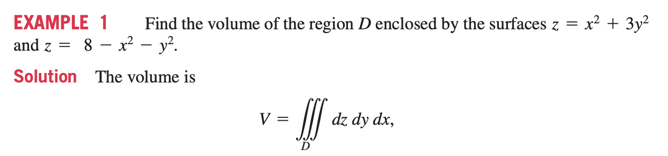

Slide 13
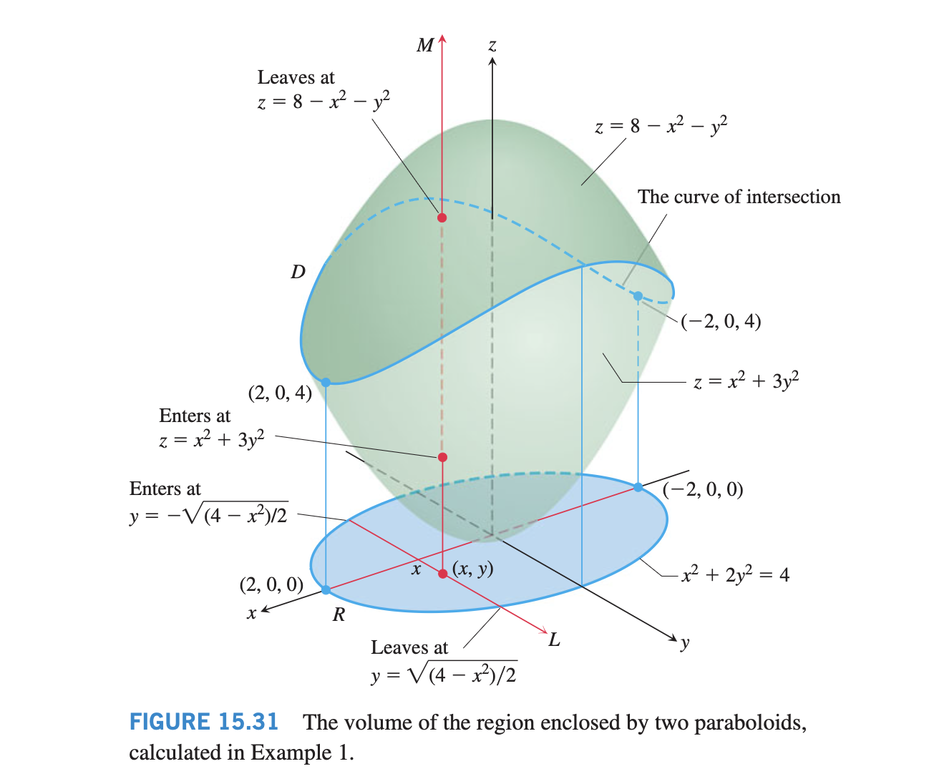

Slide 14
